Slide 1
CSE 471: MACHINE LEARNING
Modern CNN architectures

Slide 2
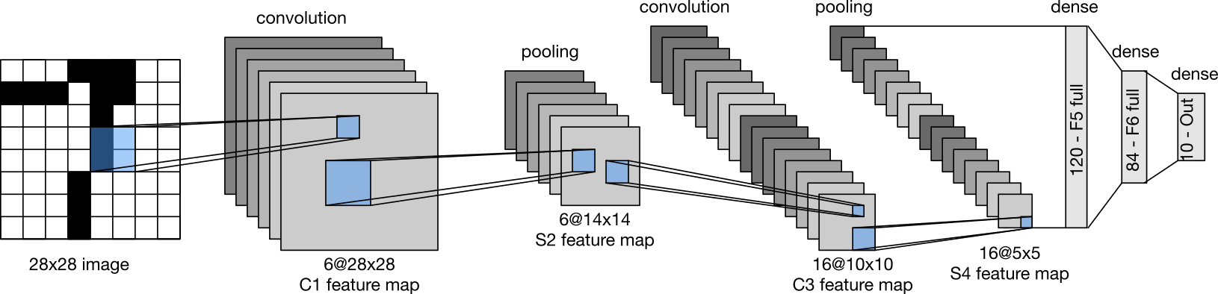
LeNet
Input: Hand written digits (single channel)
Output: Probability over 10 possible outcomes
At a high level, LeNet (LeNet-5) consists of two parts
  A convolutional encoder consisting of two convolutional layers
  A dense block consisting of three fully connected layers
LeCun, Y., Bottou, L., Bengio, Y., Haffner, P., & others. (1998). Gradient-based learning applied to document recognition. Proceedings of the IEEE, 86(11), 2278–2324.

Slide 3
LeNet
Convolution block
  Convolutional layer (5 x 5 kernel)
  Sigmoid activation
  Average pooling
    2 x 2 (stride 2)
    Spatial down sampling
  Output channels
    Layer 1: 6 @ 28 x 28
    Layer 2: 16 @ 10 x 10
Feature map is flattened before passing onto the dense layer

Slide 4
LeNet
Dense block
  3 Fully connected layers
    Layer 1: 120 neurons
    Layer 2: 84 neurons
    Layer 3: 10 neurons

Slide 5
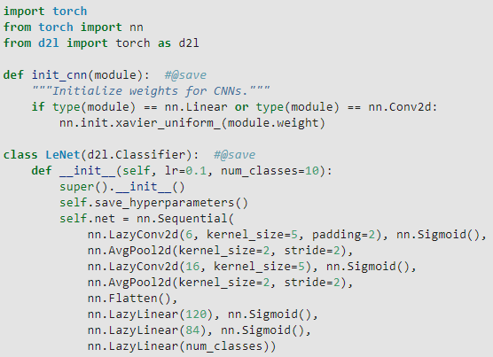
LeNet (PyTorch)
Notes:
We take some liberty in the reproduction of LeNet insofar as we replace the Gaussian activation layer (e^{-x^2}) by a softmax layer. This greatly simplifies the implementation, not the least due to the fact that the Gaussian decoder is rarely used nowadays. Other than that, this network matches the original LeNet-5 architecture.

Slide 6
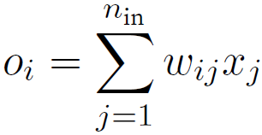
Xavier Initialization
Let
  O_{i} – output for some fully-connected layer (without nonlinearities)
  There are n_{in} inputs x_{j} with associated weights w_{ij}
  Weights are drawn independently from the same distribution, with 0 mean, σ² variance
  x_{i}’s also have 0 mean, γ² variance
    Independent of weights
    Independent of each other
Glorot, X., & Bengio, Y. (2010). Understanding the difficulty of training deep feedforward neural networks. Proceedings of the thirteenth international conference on artificial intelligence and statistics (pp. 249–256).

Slide 7
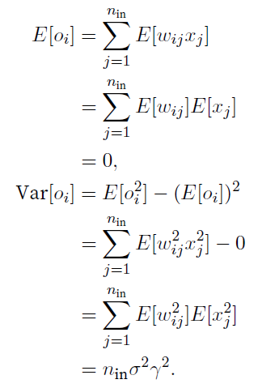
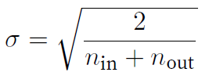
Xavier Initialization
Variance can be kept fixed if
  n_{in}σ² = 1
Following same reasoning, during backprop. Gradients’ variance can be kept fixed if
  n_{out}σ² = 1
Therefore, we try to achieve
  0.5 x (n_{in} + n_{out}) σ² = 1

Slide 8
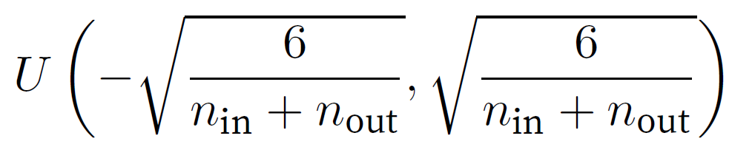
Xavier Initialization
Sampling weights from N(0, σ²)
Sampling weights from uniform distribution U(-a, a)

Slide 9
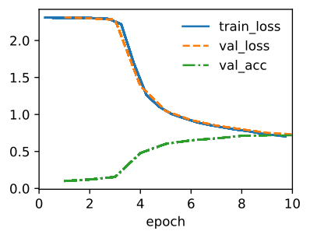
LeNet

Slide 10
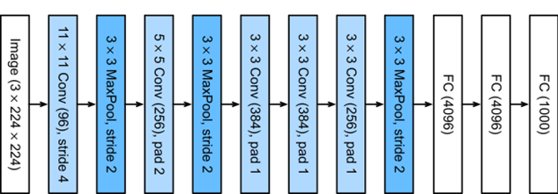
AlexNet
Runs on GPU hardware
Won the ImageNet Large Scale Visual Recognition Challenge 2012 by a phenomenally large margin
Architecture
  5 Convolutional layers
  3 fully connected layers
  ReLU activation
Krizhevsky, A., Sutskever, I., & Hinton, G. E. (2012). Imagenet classification with deep convolutional neural networks. Advances in neural information processing systems (pp. 1097–1105).

Slide 11
AlexNet
Input: 224 x 224 3-channel
11 x 11 filter in the first layer
10 times more convolution channels/filters than LeNet
Uses dropout
Image augmentation
  Flipping
  Clipping
  Color changes

Slide 12
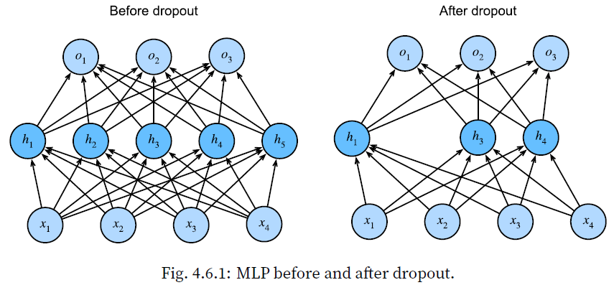
Dropout

Slide 13
Dropout
Drop out some neurons during training
  On each iteration
  Layer by layer
  Different neurons will get dropped in different iterations
Breaks up co-adaptation
Co-adaptation. Neural network overfitting is characterized by a state in which each layer relies on a specific pattern of activations in the previous layer.

Slide 14
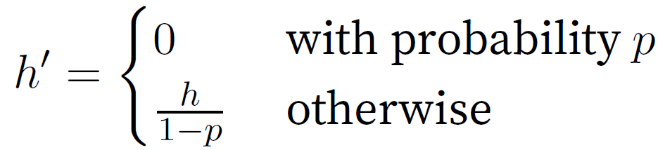
Dropout
Need to normalize the activation of the retained nodes
Each intermediate activation h is replaced by a random variable h′
Expectation remains unchanged, i.e., E[h′] = h.

Slide 15
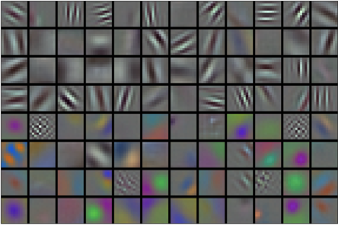
Learned filters (96)

Slide 16
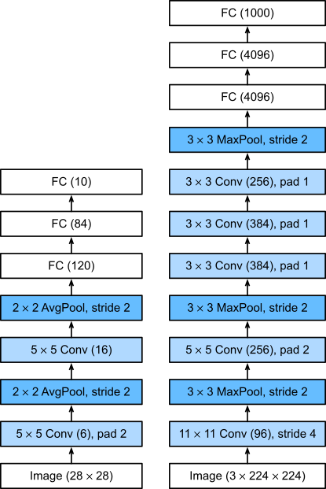
AlexNet
LeNet
AlexNet

Slide 17
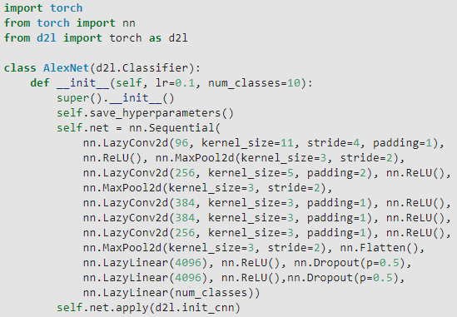
AlexNet (PyTorch)

Slide 18
VGG
Visual Geometry Group (VGG) at Oxford University
Neurons → Layers → Blocks
Basic VGG block
  A convolution layer with padding
  A nonlinearity (e.g. ReLU)
  A pooling layer (e.g. max pooling)
In the original VGG paper, the authors employed convolutions with 3x3 kernels with padding of 1 (keeping height and width) and 2x2 max pooling with stride of 2 (halving the resolution after each block)
Simonyan, K., & Zisserman, A. (2014). Very deep convolutional networks for large-scale image recognition. arXiv preprint arXiv:1409.1556.
Notes:
the Visual Geometry Group96 (VGG) at Oxford University, in their eponymously-named VGG network.

Slide 19
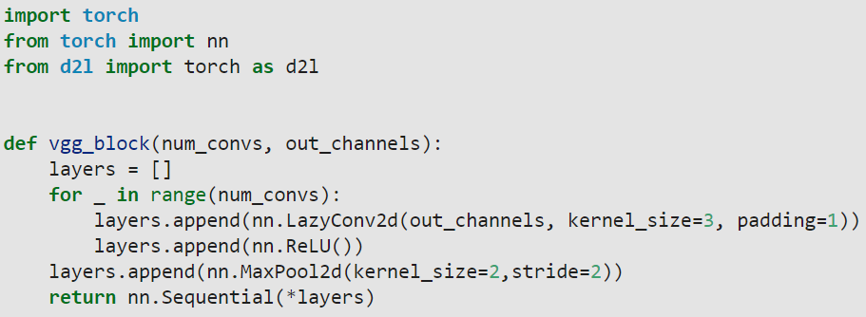
VGG

Slide 20
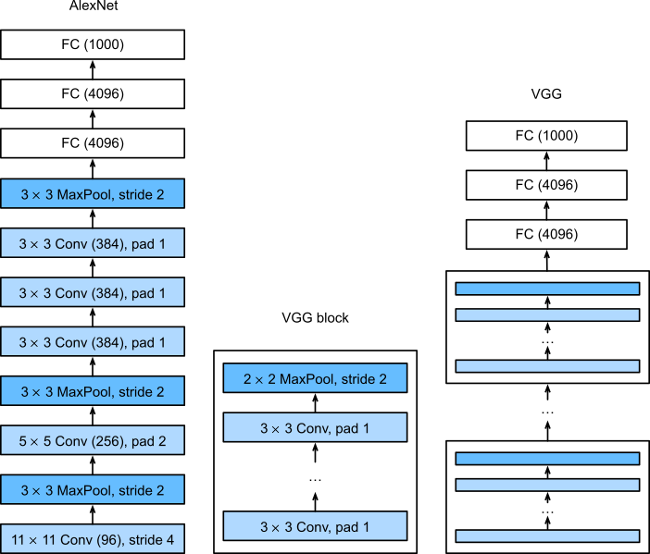
VGG

Slide 21
Original VGG network
5 convolutional blocks
  Block# 1, 2: 1 Conv. layer each
  Block# 3, 4, 5: 2 Conv. layer each
Fully connected block
  Same as AlexNet
Called VGG-11
  8 Conv. Layers
  3 FC layers
Uses dropout

Slide 22
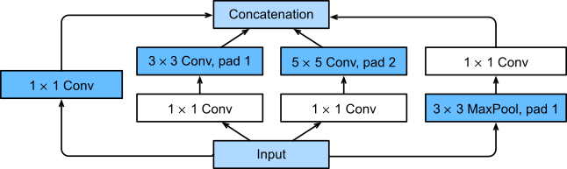
GoogLeNet
Won ImageNet challenge in 2014.
Investigated which sized kernels are best.
  Employ a combination of variously-sized kernels
The basic block is called Inception Block.
Szegedy, C., Liu, W., Jia, Y., Sermanet, P., Reed, S., Anguelov, D., … Rabinovich, A. (2015). Going deeper with convolutions. Proceedings of the IEEE conference on computer vision and pattern recognition (pp. 1–9).

Slide 23
Inception Block
4 parallel paths
  Path# 1: 1x 1 filter
  Path# 2: 3 x 3 filter, pad = 1
    1 x 1 filter used beforehand to reduce channels
  Path# 3: 5 x 5 filter, pad = 2
    1 x 1 filter used beforehand to reduce channels
  Path# 4: 3 x 3 MaxPool, pad = 1
    1 x 1 filter used afterwards to reduce channels
Input and output have the same height and width
Channel count varies in the different paths and are concatenated

Slide 24
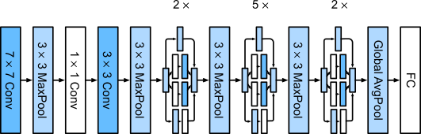
GoogLeNet

Slide 25
GoogLeNet
7x7 filter, stride=2, pad=3, 64 channels
3x3 maxpooling
1x1 filter – 64 channels
3x3 filter – 192 channels
2 inception blocks in series
  Block# 1: 64 + 128 + 32 + 32 = 256 channels
  Block #2: 128 + 192 + 96 + 64 = 480 channels
And so on …

Slide 26


Residual networks (ResNet)
Each layer completely replaces the representation from the preceding layer,
Whereas traditional networks must learn to propagate information and are subject to catastrophic failure of information propagation for bad choices of the parameters, residual networks propagate information by default

Slide 27
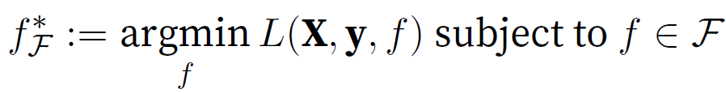
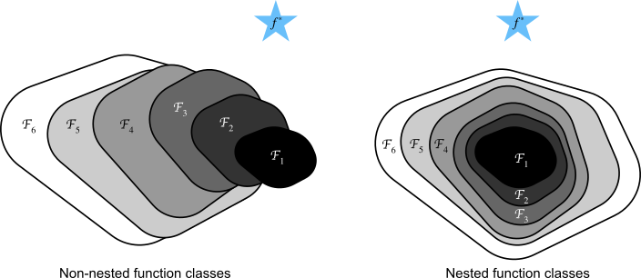
Functional classes
For non-nested function classes, a larger (indicated by area) function class does not guarantee to get closer to the “truth” function (f*). This does not happen in nested function classes.

Slide 28
ResNet (Intuition)
For deep neural networks, if we can train the newly-added layer into an identity function f(x) = x, the new model will be as effective as the original model.
As the new model may get a better solution to fit the training dataset, the added layer might make it easier to reduce training errors.
Won the ImageNet Large Scale Visual Recognition Challenge in 2015.

Slide 29
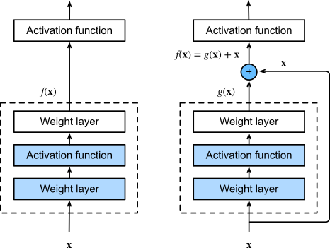
ResNet Block
Notes:
In a regular block (left), the portion within the dotted-line box must directly learn the mapping f(x). In a residual block (right), the portion within the dotted-line box needs to learn the residual mapping g(x)=f(x)−x, making the identity mapping f(x)=x easier to learn.

Slide 30
ResNet Block
Two 3x3 convolution layers
  Same number of output channels
Batch normalization
ReLU activation

Slide 31
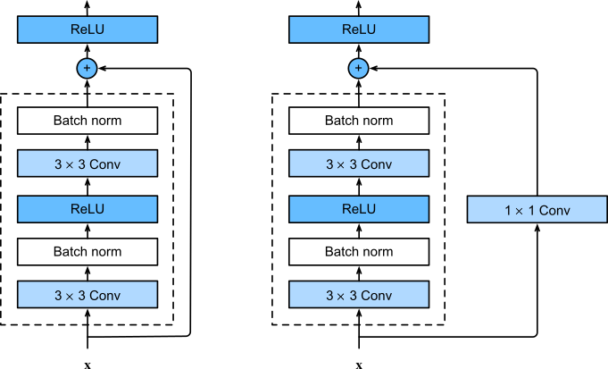
ResNet Block
Identical input/output channels
Non-identical input/output channels

Slide 32
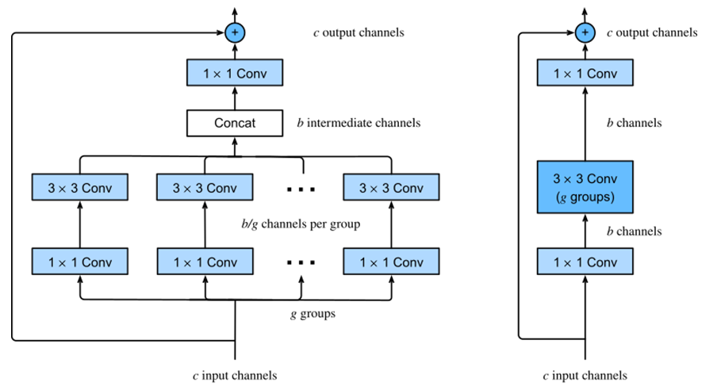
ResNext block
Simplified diagram
The use of grouped convolution with g groups is g times faster than a dense convolution. It is a bottleneck residual block when the number of intermediate channels b is less than c.
Notes:
The use of grouped convolution with g groups is g times faster than a dense convolution. It is a bottleneck residual block when the number of intermediate channels b is less than c.

